Slide 1
CAPÍTULO 13
TROCA DE RADIAÇÃO
ENTRE SUPERFÍCIES
TRANSMISSÃO DE CALOR E MASSA

Slide 2
Radiation Exchange Between Surfaces:
Enclosures with Nonparticipating Media
Chapter 13
Sections 13.1 through 13.4

Slide 3
Basic Concepts
Basic Concepts
Enclosures consist of two or more surfaces that envelop a region of space
(typically gas-filled) and between which there is radiation transfer.
Virtual,
as well as real, surfaces may be introduced to form an enclosure.
A nonparticipating medium within the enclosure neither emits, absorbs,
nor scatters radiation and hence has no effect on radiation exchange
between the surfaces.
Each surface of the enclosure is assumed to be isothermal, opaque, diffuse
and gray, and to be characterized by uniform radiosity and irradiation.

Slide 4
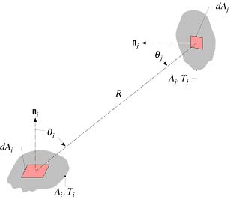
View Factor Integral
The View Factor (also Configuration or Shape Factor)
The view factor, is a geometrical quantity corresponding
to the fraction of the radiation leaving surface i that is intercepted by
surface j.
The view factor integral provides a general expression for
Consider exchange
between differential areas

Slide 5
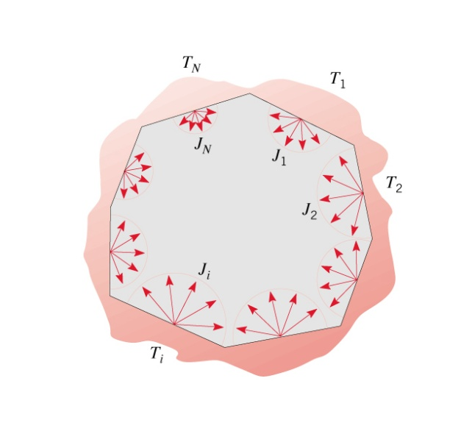
View Factor Relations
View Factor Relations
Reciprocity Relation.
With
Summation Rule for Enclosures.

Slide 6
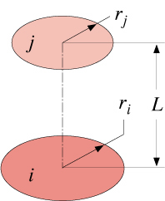
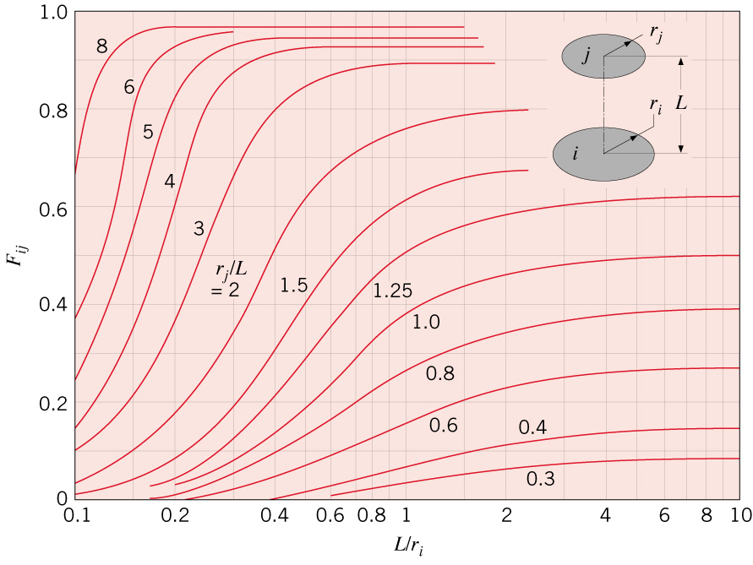
View Factor Relations (cont)
Three-Dimensional Geometries (Table 13.2).
For example,
Coaxial Parallel Disks

Slide 7
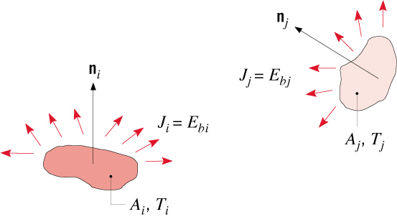
Blackbody Enclosure
Blackbody Radiation Exchange
For a blackbody,
Net radiative exchange between two
surfaces that can be approximated as
blackbodies
net rate at which radiation
leaves surface i due to its
interaction with j
or net rate at which surface
j gains radiation due to its
interaction with i
Net radiation transfer from surface i due to exchange with all (N)
surfaces of an enclosure:

Slide 8

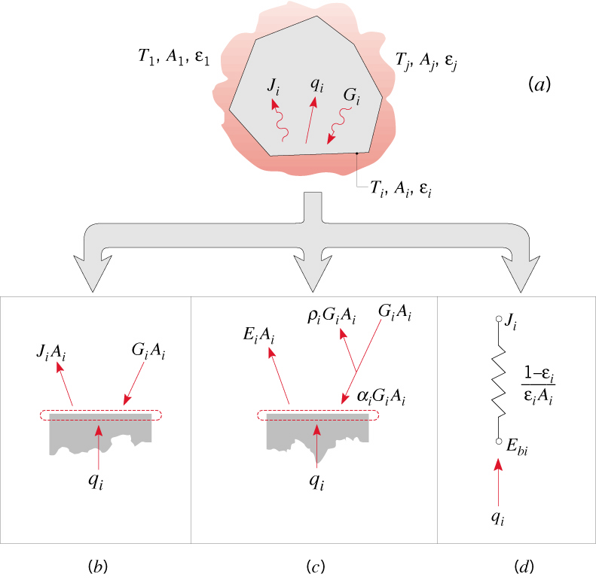
General Enclosure Analysis
General Radiation Analysis for Exchange between the N
Opaque, Diffuse, Gray Surfaces of an Enclosure
Alternative expressions for net radiative
transfer from surface i:
(3)
Suggests a surface radiative
resistance of the form:

Slide 9
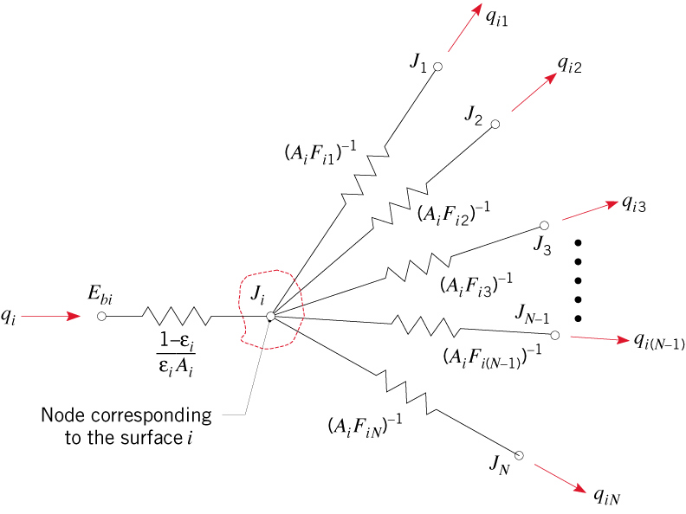
General Enclosure Analysis (cont)
(4)
Suggests a space or geometrical
resistance of the form:
Equating Eqs. (3) and (4) corresponds to a radiation balance on surface i:
(5)
which may be represented by a radiation network of the form

Slide 10
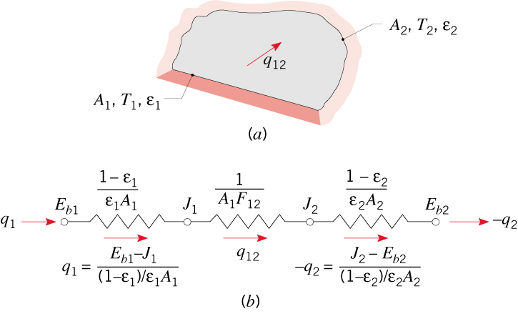
Two-Surface Enclosures
Two-Surface Enclosures
Simplest enclosure for which radiation exchange is exclusively between two
surfaces and a single expression for the rate of radiation transfer may be
inferred from a network representation of the exchange.

Slide 11
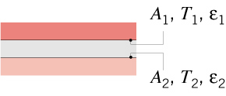
Two-Surface Enclosures (cont)
Special cases are presented in Table 13.3.
For example,
Large (Infinite) Parallel Plates
Note result for Small Convex Object in a Large Cavity.

Slide 12
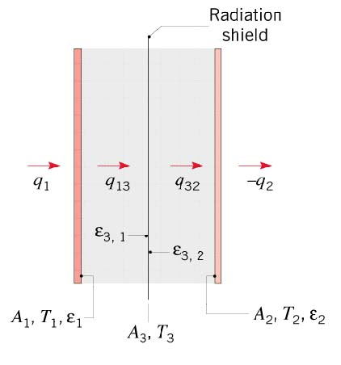
Radiation Shield
Radiation Shields
High reflectivity (low ) surface(s) inserted between two surfaces for which
a reduction in radiation exchange is desired.
Consider use of a single shield in a two-surface enclosure, such as that associated with
large parallel plates:
Note that, although rarely the case, emissivities may differ for opposite surfaces
of the shield.

Slide 13
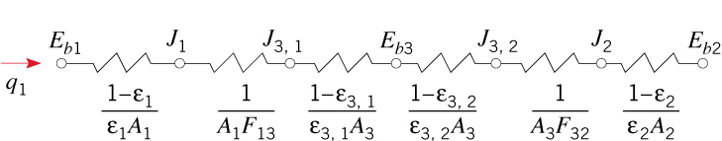
Radiation Shield (cont)
Radiation Network:
The foregoing result may be readily extended to account for multiple shields
and may be applied to long, concentric cylinders and concentric spheres,
as well as large parallel plates.

Slide 14

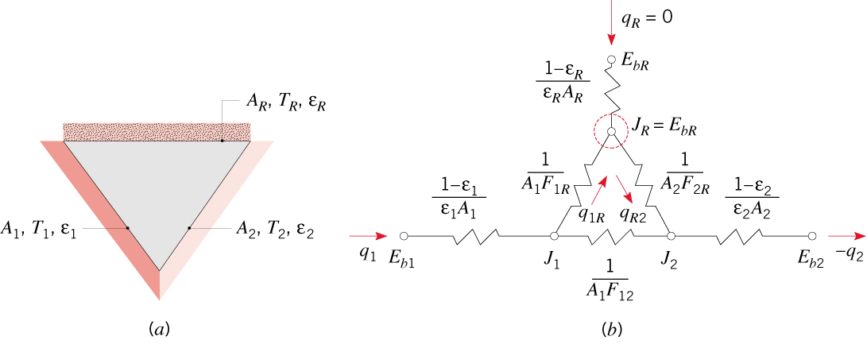
Reradiating Surfaces
The Reradiating Surface
An idealization for which
Hence,
Approximated by surfaces that are well insulated on one side and for which
convection is negligible on the opposite (radiating) side.
Three-Surface Enclosure with a Reradiating Surface:

